Slide 1
INDUSTRIAL ENGINEERING
SERVICE
Kolkata
A Profile
SEPTEMBER 2023

Slide 2
Incorporated in 2018.
The entrepreneurs belong to the technical fraternity with rich working experience.
Services Include:
Engineering Service
Support Services for Inspection
Commissioning Service to Ash Handling Plant
The Company
Working Experience with:
National Thermal Power Corporation (NTPC)
West Bengal Power Development Corporation (WBPDCL)
Development Consultants Pvt. Ltd. (DCPL)
Larsen Tubro (L&T)
Technip Germany
DC Industrial Plant Services Pvt. Ltd. (DCIPS)

Slide 3
IES Business Vision — Mindset of Delivering Technical Superiority
Competent People — Availability of Engineers, Designers & Drafting people upto 40 years of experience with rich knowledge of Engineering
Availability of large Data Bank
Pioneering Indigenous Technologies
Strengths
Design Capabilities include:
Water Supply & Recovery system
Material Handling Systems be it pneumatic or hydraulic or mechanical
Plant Compressed Air Supply & Distribution system
Cross-country Water & Slurry Pumping System
Miscellaneous Slurry Handling Systems & Garlanding of Disposal Pond
Fuel Oil Handling system
Air Conditioning system
Ventilation system

Slide 4
Preparation of Design Basis Report.
Basic Engineering & Detail engineering in offsite facilities.
Preparation of single line flow diagrams.
Preparation of layout drawings related to equipment housing
Equipment layout and related piping configuration.
Piping layout on piping racks, inter building connection.
Cross-country water & slurry piping layouts with support details
Preparation of equipment specification eg. pumps, blowers, compressors, HVAC system etc.
Review of Vendors’ offers.
Assistance in vendor selection and order placement.
Review of vendor’s Drawings & Data-Sheets.
Preparation of Bill of Material and take-off schedule.
Preparation of Civil Assignment drawings.
Capability in
Design Engineering

Slide 5
IES has bagged till date orders amounting to about 4 crores out of which exports worth about 82 thousand Euros (which includes spares supply also).
Presently, IES is in the process of completing detail engineering service for Ash Handling of 5 x 800 MW Power Plant at Yadadri, Telangana district.
Orders Executed

Slide 6
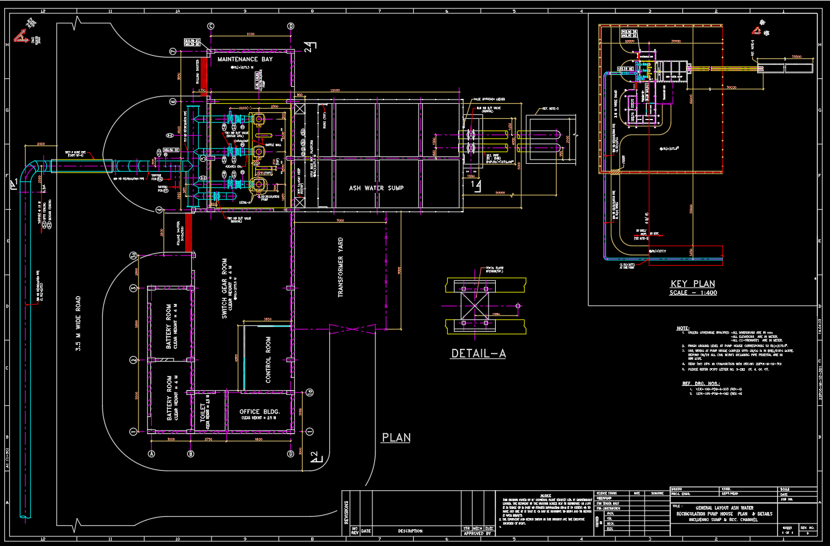
Exhibit – 01
Recirculation Pump House

Slide 7
Exhibit – 02
GENERAL LAYOUT OF WATER RECIRCULATION PUMP HOUSE

Slide 8
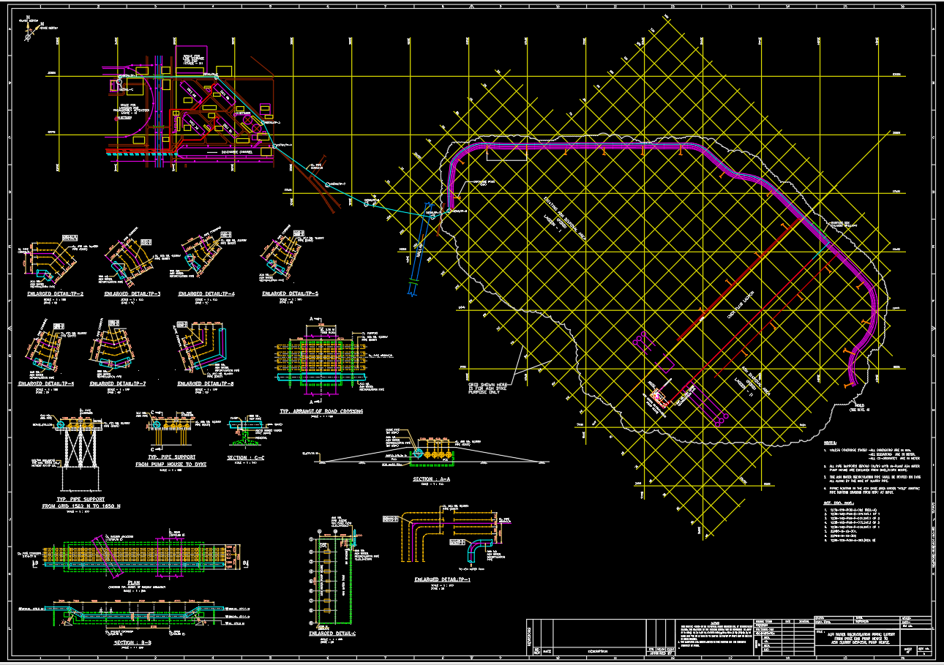
Exhibit – 03
Pump House TO DYKE SLURRY DISPOSAL SYSTEM

Slide 9
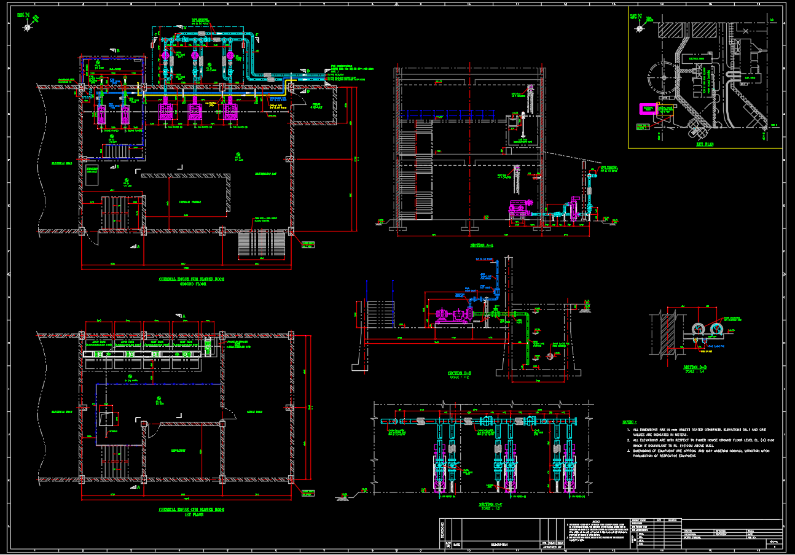
Exhibit – 04
GENERAL LAYOUT OF CHEMICAL HOUSE

Slide 10
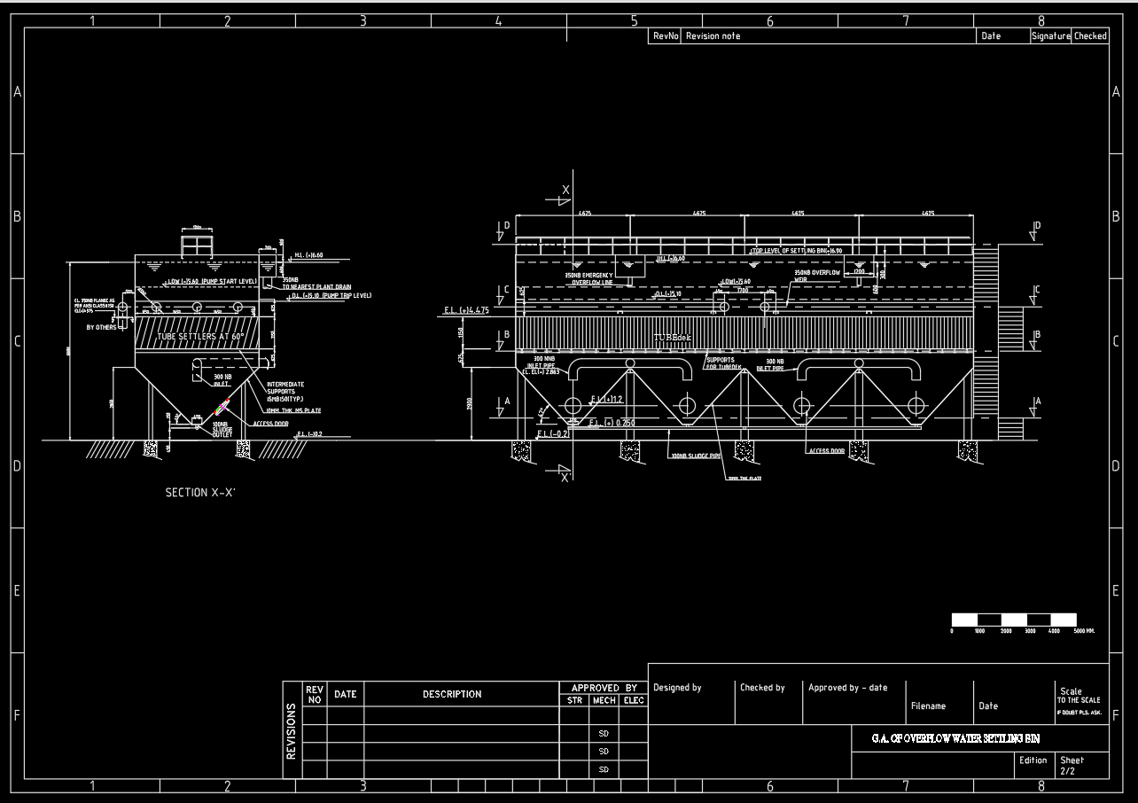
Exhibit – 05
SETTLING BIN

Slide 11
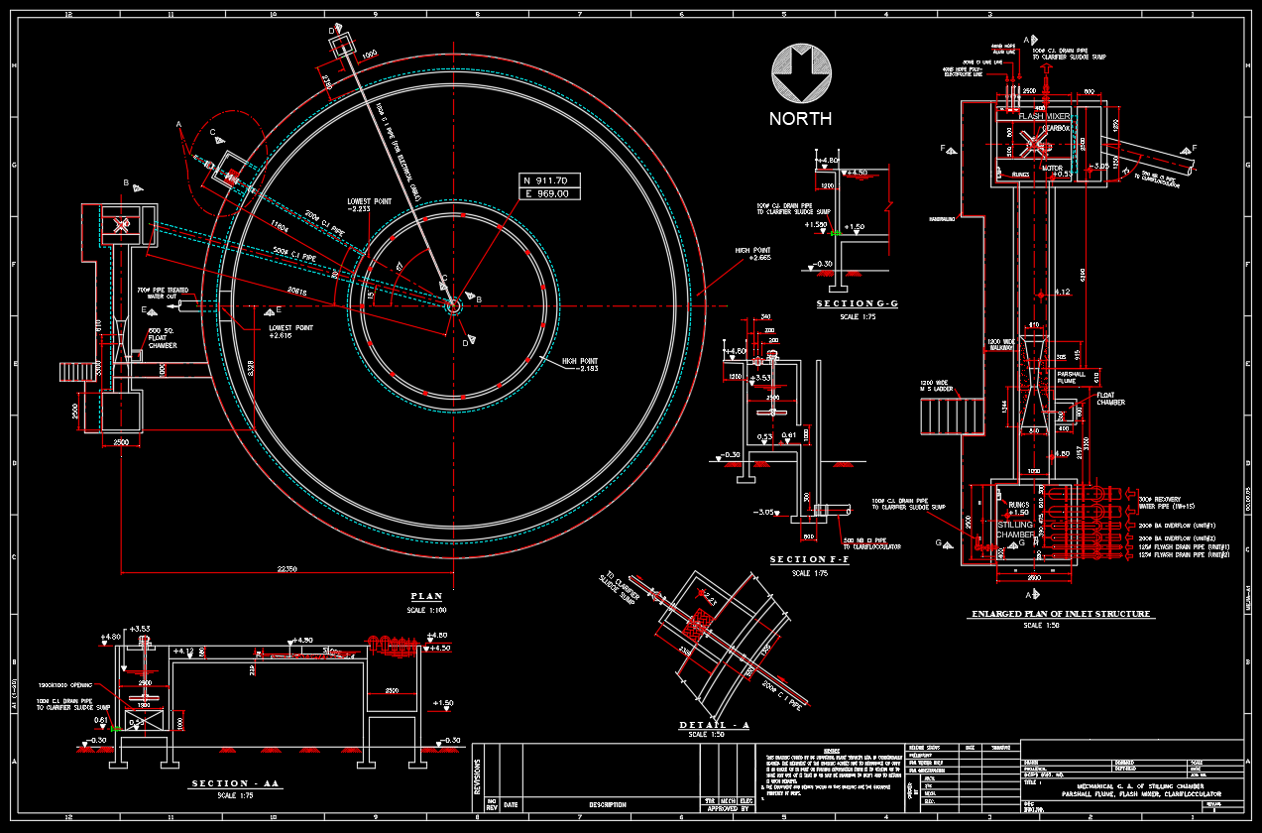
Exhibit – 06
PLAN OF CLARIFIER

Slide 12
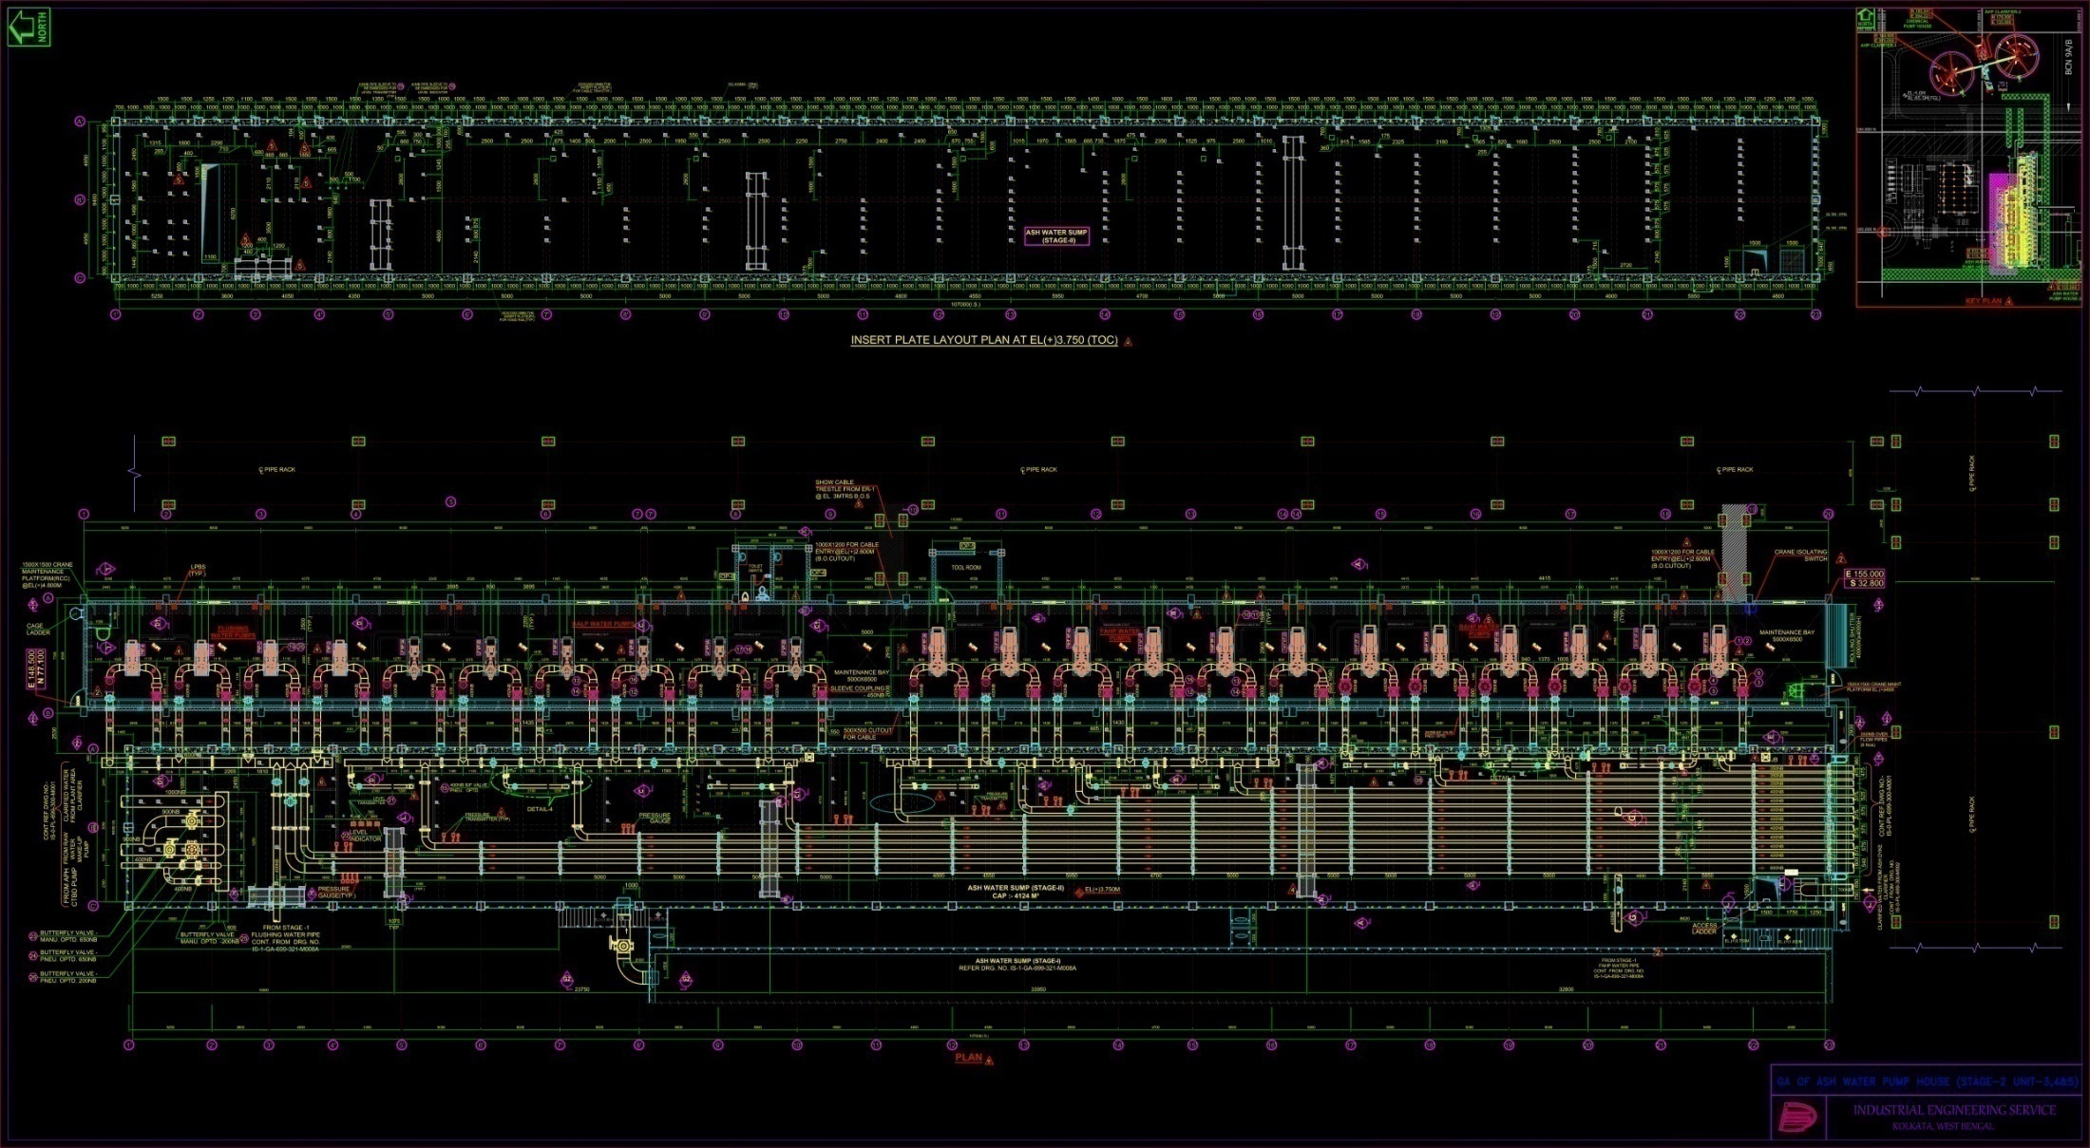
Exhibit – 07
GA OF ASH WATER PUMP HOUSE - plan

Slide 13
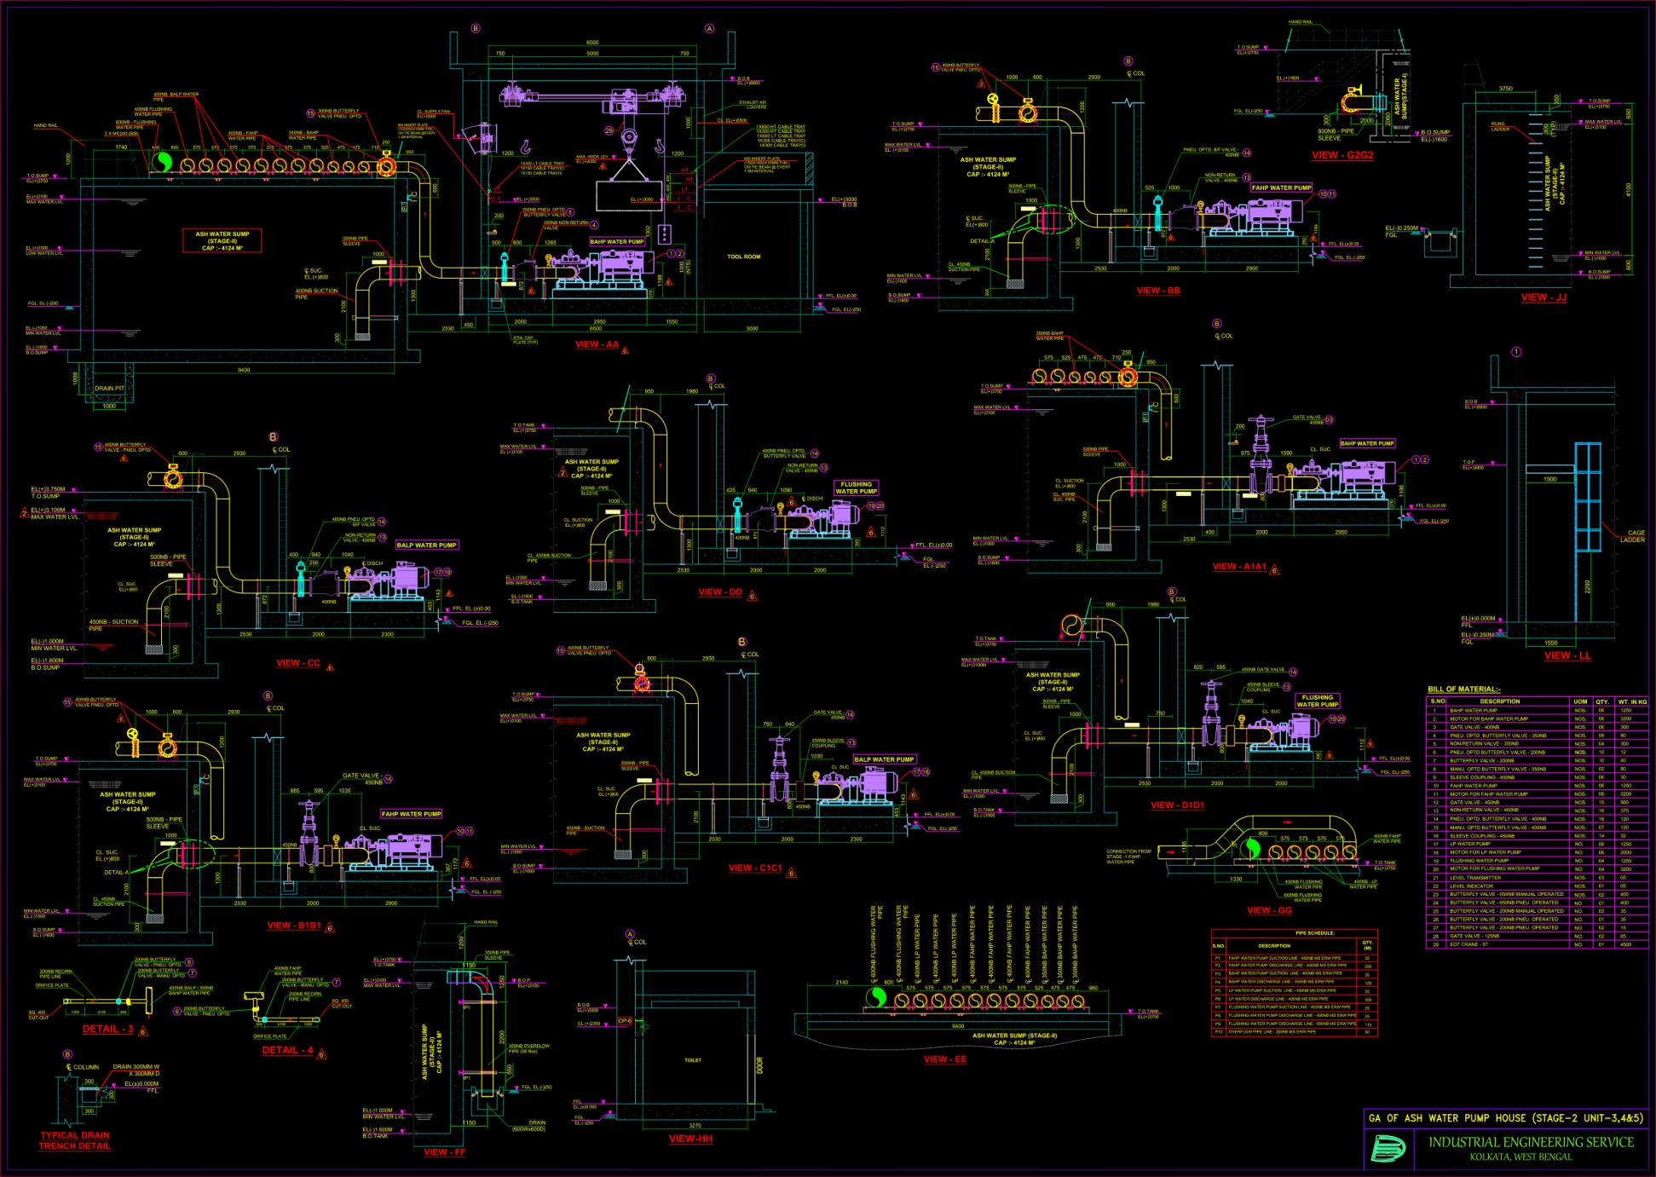
Exhibit – 08
GA OF ASH WATER PUMP HOUSE - section

Slide 14
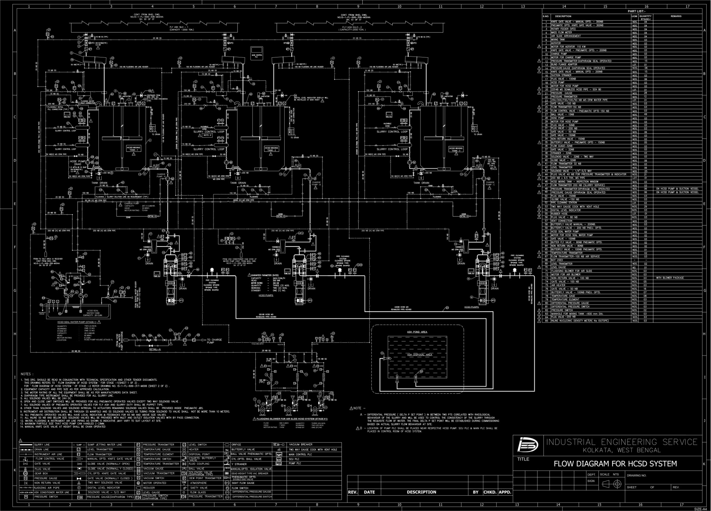
Exhibit – 09
SLFD HCSD SYSTEM

Slide 15
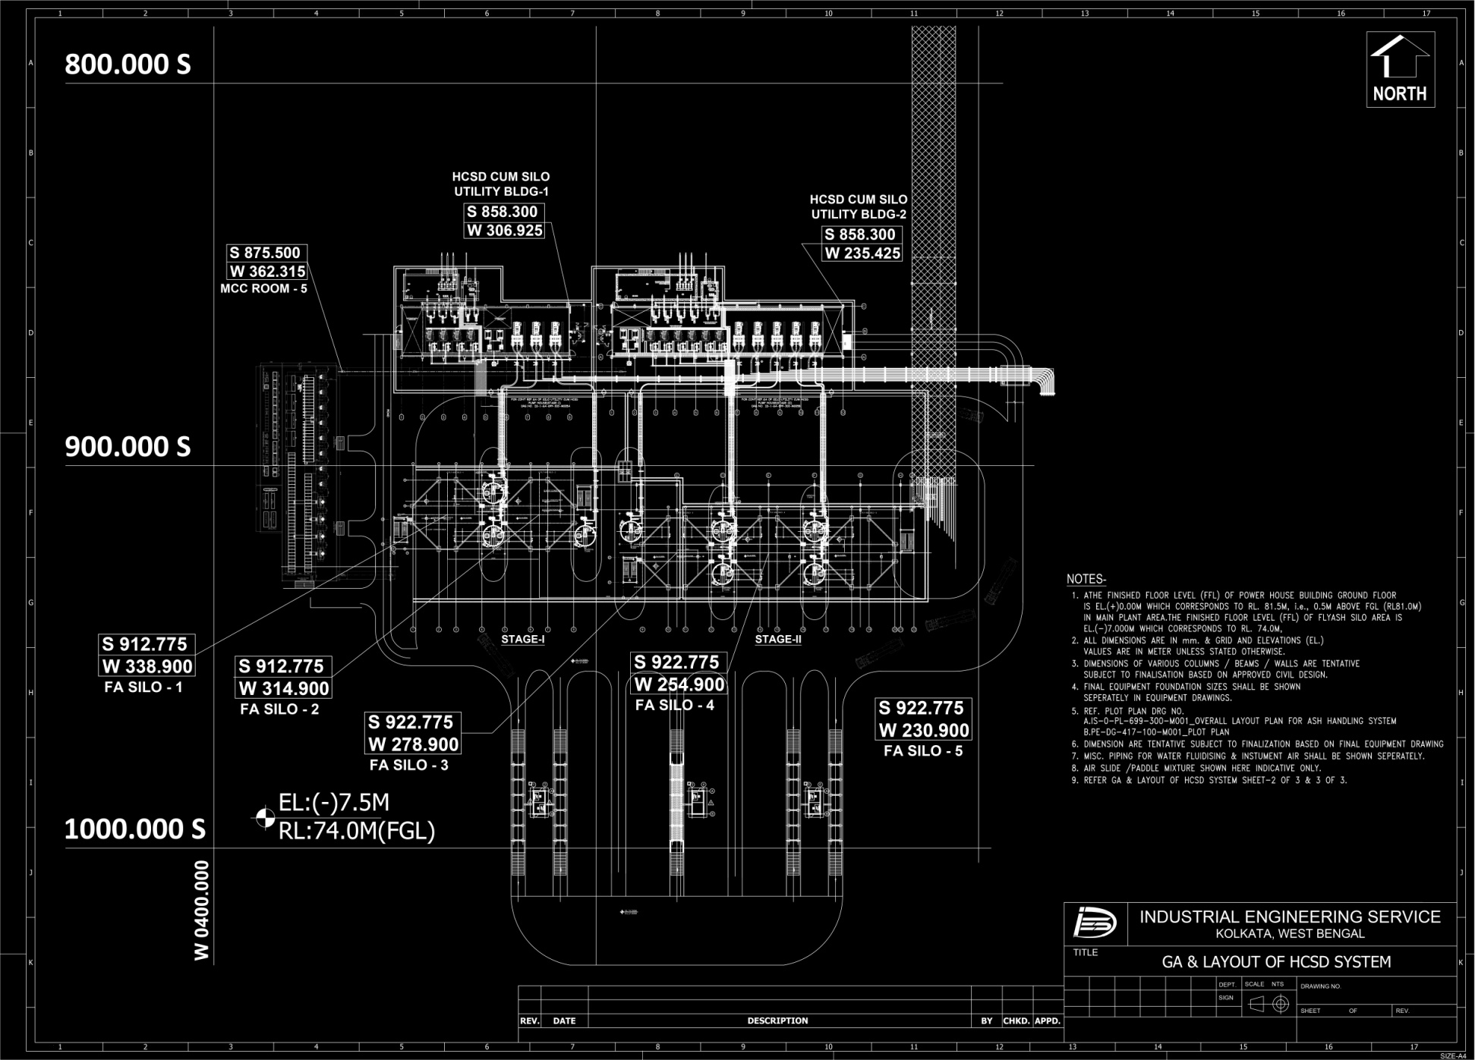
Exhibit – 10
GA & LAYOUT OF HCSD SYSTEM

Slide 16
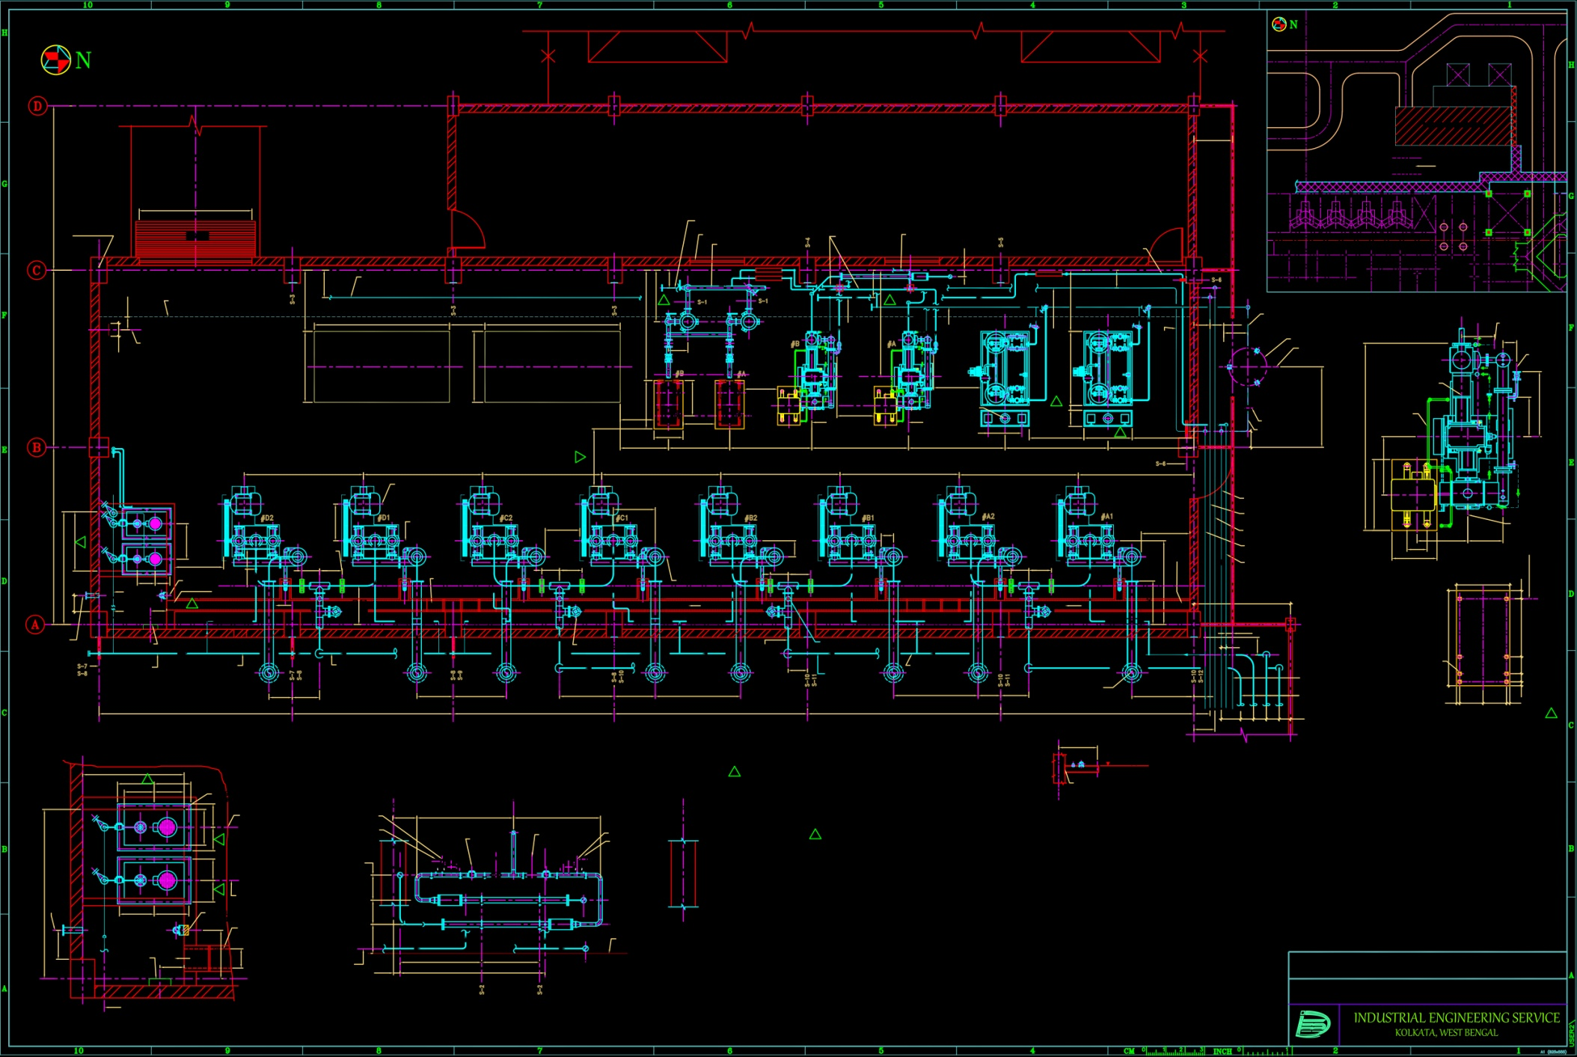
Exhibit – 11
GA of vacuum pump house - PLAN

Slide 17
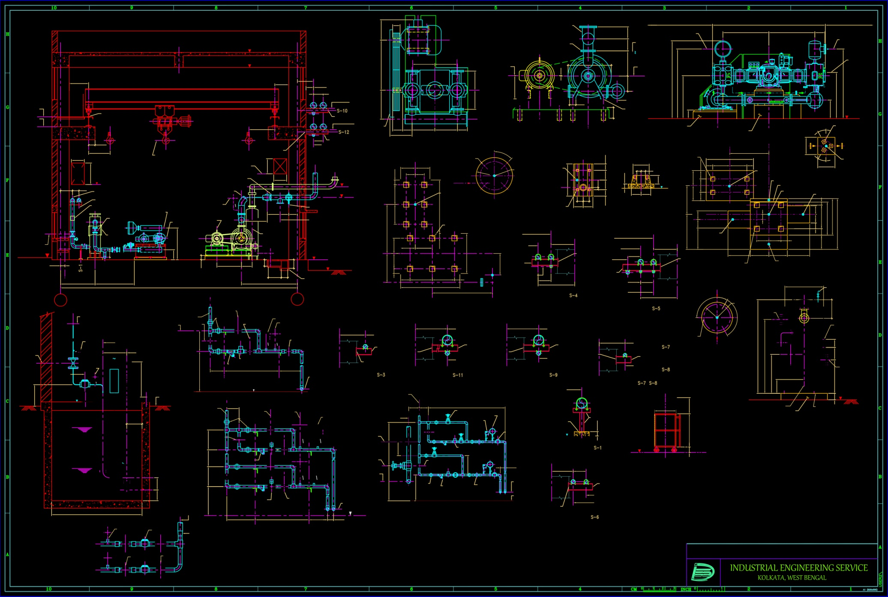
Exhibit – 12
GA of vacuum pump house - SECTION

Slide 18
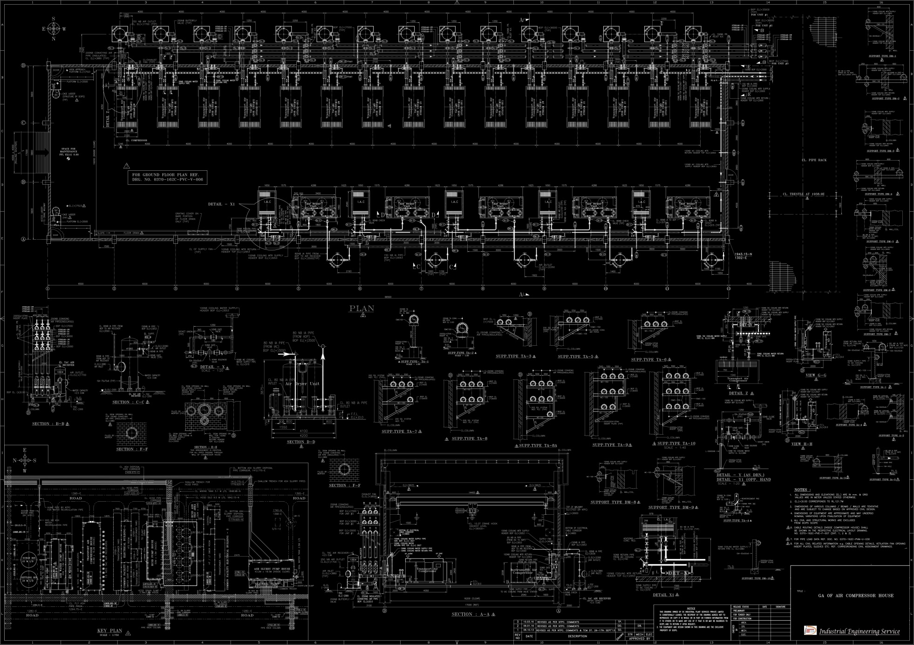
Exhibit – 13
GA of COMPRESSOR HOUSE

Slide 19
Dibyendu Basu
45 years experience in Engineering and O&M in Development Consultant & as Managing Director in DC Industrial Plant Services Pvt. Ltd.
Amit Biswas
40 years experience in Engineering in Development Consultant & former Director, Mechanical Design in DC Industrial Plant Services Pvt. Ltd.
Debasish Bhattacharyya
35 years experience in Engineering in Development Consultant & former ED, Mechanical Design in DC Industrial Plant Services Pvt. Ltd.
Members Responsible for Operation
Sunil Ghosh
37 years experience in Engineering in Development Consultant & former GM, Mechanical Design in DC Industrial Plant Services Pvt. Ltd.
Subhendu Ghosh
20 years experience as General Manager (Operation & Maintenance) in DC Industrial Plant Services Pvt. Ltd.
Debaprasad Mukherjee
20 years experience as Asst. General Manager (Mechanical Design) in DC Industrial Plant Services Pvt. Ltd.

